Slide 1
WEB 2.0 Programming with AJAX
E.Soundararajan
SIRD, IGCAR

Slide 2




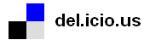
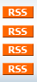
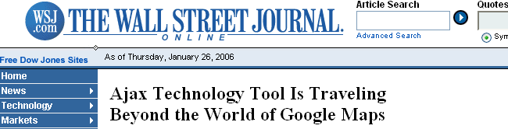

Web 2.0 Fly By
Web 2.0 is really an “after-the-fact” catch-all for a collectively recognized phenomena
the foaf project
Notes:
Adsense – adds (and rewards) targeted advertisements at any Internet site. A google product
Flickr – rich, powerful picture sharing, and organizing tool
BitTorrent – powerful P2P sharing and distribution
Blog – Easy add and comment journal-like web sites.

Slide 3
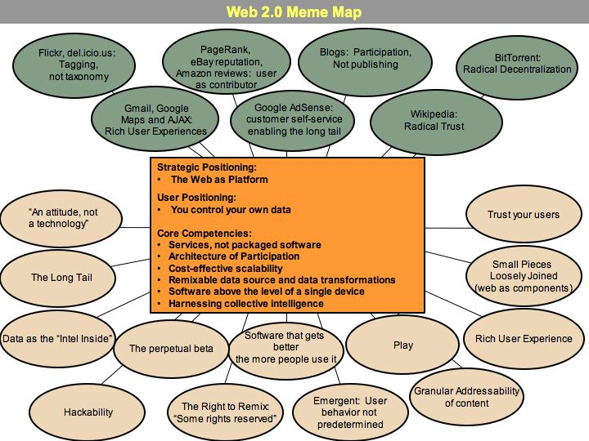

Slide 4
Web 2.0 is the network as platform, spanning all connected devices; Web 2.0 applications are those that make the most of the intrinsic advantages of that platform: delivering software as a
continually-updated service that gets better the more people use it, consuming and remixing data from multiple sources, including individual users, while providing their own data and services in a form that allows remixing by others, creating network effects through an "architecture of participation," and going beyond the page metaphor of Web 1.0 to deliver
rich user experiences.
Tim O'Reilly, “Web 2.0: Compact Definition?”

Slide 5
Lets continue looking...

Slide 6
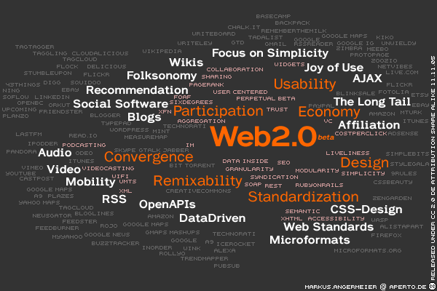

Slide 7
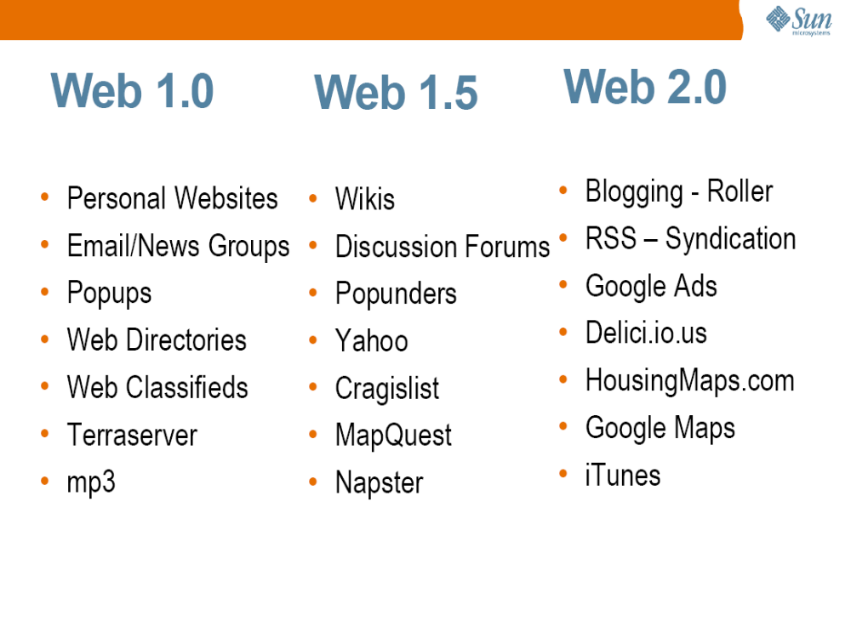

Slide 8
What Makes the Web 2.0 Different?
• Personalized
• User oriented
• Easy to Use
• Get you to the information you want
• Useful

Slide 9
Characteristics of Conventional
Web Application
• “Click, wait, and refresh” user interaction
> Page refreshes from the server needed for all events, data submissions, and navigation
> The user has to wait for the response
• Synchronous “request/response” communication model
• Browser always initiates the request

Slide 10
Issues of Conventional
Web Application
• Slow response
• Loss of operation context during refresh
• Excessive server load and bandwidth consumption
• Lack of two-way, real-time communication capability
for server initiated updates
These are the reasons why Rich Internet Application
(RIA) technologies were born.

Slide 11
Rich Internet Application (RIA)
Technologies
• Macromedia Flash
• Java Web Start
• DHTML
• DHTML with IFrame
• AJAX

Slide 12
Macromedia Flash
• Designed for playing interactive movies
• Programmed with ActionScript
• Implementation examples
> Macromedia Flex
> Laszlo suite (open source)
• Pros:
> Good for vector graphics
• Cons:
> Browser needs a Flash plug-in
> ActionScript is proprietary and hard to debug

Slide 13
Java Web Start
• Desktop application delivered over the net
• Pros
> Desktop experience once loaded
> Leverages Java technology to its fullest extent
> Disconnected operation possible
> Application can be digitally signed
• Cons
> Old JRE-based system do not work

Slide 14
DHTML (Dynamic HTML)
• DHTML = JavaScript + DOM + CSS
• Used for creating interactive applications
• No asynchronous communication, however
> Full page refresh still required

Slide 15
Introduction
AJAX = Asynchronous JavaScript and XML
AJAX is not a new programming language, but a technique for creating better, faster, and more interactive web applications.
With AJAX, your JavaScript can communicate directly with the server, using the JavaScript XMLHttpRequest object. With this object, your JavaScript can trade data with a web server, without reloading the page.
AJAX uses asynchronous data transfer (HTTP requests) between the browser and the web server, allowing web pages to request small bits of information from the server instead of whole pages.
The AJAX technique makes Internet applications smaller, faster and more user-friendly.

Slide 16
About AJAX
AJAX is Based on Web Standards
AJAX is based on the following web standards:
JavaScript
XML
HTML
CSS
DOM
The web standards used in AJAX are well defined, and supported by all major browsers. AJAX applications are browser and platform independent.

Slide 17
DOM (Document Object Model)
Object Oriented Representation for XML and HTML documents
Based on Hierarchical (Tree) Structure
allows programs and scripts to build documents, navigate their structure, add, modify or delete elements and content
Provides a foundation for developing
querying, filtering,
transformation, rendering etc.
applications on top of DOM implementations

Slide 18
CSS (Cascading Style Sheets)
Set of Formatting rules that tell the browser how to present the document
Helps to separate the content from the presentation
Reduce the download time by removing the formatting information from the document
More control over formatting than HTML

Slide 19
So why is AJAX so hot—NOW?
Demand for richer applications is growing
  Broadband means we can—and want to—do more
Recent Google applications have sparked people’s imagination
  Google gmail, Google suggests, Google Maps
People are thinking of building APPLICATIONS…not just sites
The Tipping Point
  All of this has made rich internet apps reach its tipping point—where adoption spreads rapidly and dramatically

Slide 20
Real-Life Examples of AJAX apps
• Google maps
> http://maps.google.com/
• Goolgle Suggest
> http://www.google.com/webhp?complete=1&hl=en
• Gmail
> http://gmail.com/
• ZUGGEST- an XMLHttp Experiment using Amazon
> http://www.francisshanahan.com/zuggest.aspx

Slide 21
AJAX Basics
AJAX Uses HTTP Requests
With AJAX, your JavaScript communicates directly with the server, through the JavaScript XMLHttpRequest object
With an HTTP request, a web page can make a request to, and get a response from a web server - without reloading the page. The user will stay on the same page, and he or she will not notice that scripts request pages, or send data to a server in the background.

Slide 22
AJAX Basics
The XMLHttpRequest Object
By using the XMLHttpRequest object, a web developer can update a page with data from the server after the page has loaded!
AJAX was made popular in 2005 by Google (with Google Suggest).
Google Suggest is using the XMLHttpRequest object to create a very dynamic web interface: When you start typing in Google's search box, a JavaScript sends the letters off to a server and the server returns a list of suggestions.
The XMLHttpRequest object is supported in Internet Explorer 5.0+, Safari 1.2, Mozilla 1.0 / Firefox, Opera 8+, and Netscape 7.

Slide 23
A New Way of Building Applications
AJAX Applications Are:
3-tier client/server apps
  Browser ↔ App Server ↔ Data Source
Event driven
  User clicks, user drags, user changes data
Graphics Intensive
  Visual Effects, Rich Visual Controls
Are Data Oriented
  Users are manipulating and entering data
Are Complex
  Pages hold many more controls and data than page-oriented applications
  Multiple Master-Detail Relationships in one page

Slide 24
AJAX will change web development
AJAX represents a fundamental shift in how web applications are built
We’ll be building 3-Tier Client/Server applications with AJAX
Users want enhanced, interactive functionality
They want their data easily accessible and maintainable
They don’t want screen flicker
They don’t want over-the-top GUI—just functional
Once they see an AJAX application—they want it now

Slide 25
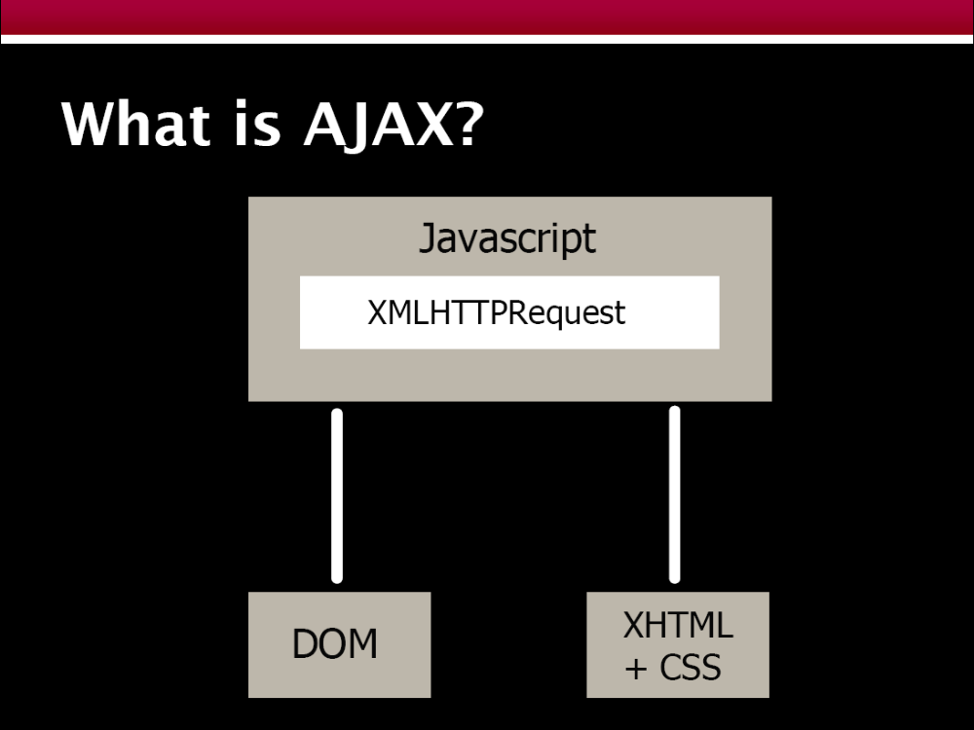

Slide 26
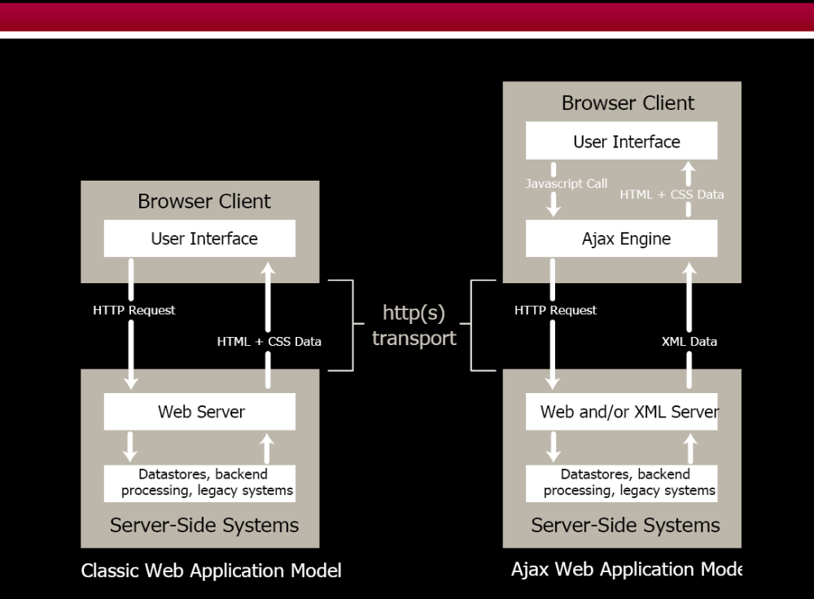

Slide 27
Two ways of talking to the server…
XMLHTTPRequest object
  Allows for asynchronous GETs + POSTs to the server
  Does not show the user anything—no status messages
  Can have multiple XMLHTTPRequest active at one time
  Allows you to specify a handler method for state changes
  Handler notified when request is:
    Initialized
    Started
    In the process of being returned
    Completely finished
  Originally only available for Microsoft IE

Slide 28
XMLHttpRequest Object: Methods
open(“method”, “URL”)
open(“method”, “URL”, async, username, password)
  Assigns destination URL, method, etc.
send(content)
  Sends request including postable string or DOM object data
abort()
  Terminates current request
getAllResponseHeaders()
  Returns headers (labels + values) as a string
getResponseHeader(“header”)
  Returns value of a given header
setRequestHeader(“label”,”value”)
  Sets Request Headers before sending

Slide 29
Security Issues
You can only hit the domain that the original web page came from
Because of this, the AJAX technique cannot normally be used to access a Web Service of a 3rd party server
  You can wrap those requests through your own server
  You can allow XMLHTTPRequest to access specific sites in your browser security settings
IFRAME can be used to access any site if needed

Slide 30
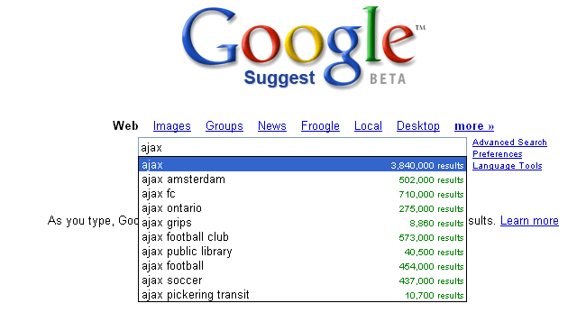
Wow..I didn’t
know soccer
teams did web programming..

Slide 31
AJAX Patterns
Change Browser Content with the DOM
  Return HTML or XML and change named items
    Usually DIVs or SPANs
Remote Scripting
  Execute business functions on the server from the client
Events & Scheduling
  Using Timers to ping server on regular basis
Specialized Functions to perform common GUI tasks
  Populate SELECT list
  Pass target DIV to replace to the server
  Instant Validation as User Works
  SAVE instead of SUBMIT
  CANCEL instead of BACK
DHTML Techniques
  CSS, Drag & Drop
Server-Side Code Generation
  Return Javascript to client

Slide 32
AJAX Frameworks
Pure JavaScript Framework
  Infrastructure
    Provides basic piping & portable browser abstractions
    Content up to developer
    Typical Functionality:
      Wrapper around XMLHttpRequest
      XML manipulation & interrogation
      DOM manipulations based on responses from XMLHttpRequest
  Application Framework
    Includes basic Infrastruture functionality
Server-Side Framework
  HTML/JavaScript Generation
    Server provides complete HTML/JS code generation and browser ←→ server coordination
    Browser-side coding is for customization
  Remote Invocation
    JavaScript calls routed directly to server-side functions (Java Methods) and returned back to Javascript callback handlers

Slide 33
Pure JavaScript
  DOJO (9/04)
  Prototype (2001)
  Open Rico (5/05)
  Qooxdoo (5/05)
Pure JavaScript Infrastructural
  AjaxJS (5/05)
  HTMLHttpRequest (2001)
  Interactive Website Framework (5/05)
  LibXMLHttpRequest (6/03)
  RSLite
  Sack (5/05)
  Sarissa (2/03)
  XHConn (4/05)
Server-Side (Multi Language)
  Cross-Platform Asynchronous Interface Toolkit (5/05)
  SAJAX (3/05)
  Javascript Object Notation (JSON) & JSON-RPC
  Javascript Remote Scripting (2000)
Server-Side (Java)
  Echo2 (3/05)
  Direct Web Remoting (DWR) (2005)]
  ThinkCAP Minerva (04/2005)
Server-Side (Lisp)
  CL-Ajax
Server-Side (.NET)
  Ajax.NET (305)
Server-Side (PHP)
  AjaxAC (4/05)
  JPSpan
  XAJAX
Server-Side (Ruby)
  Ruby-On-Rails (3/05)
Pick a
Framework…
any Framework
www.ajaxpatterns.org

Slide 34
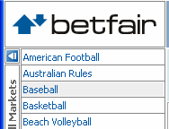
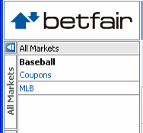
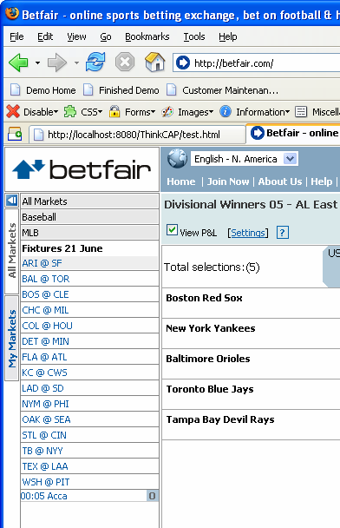
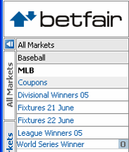
Common Widgets
Form Validation
Interactive Grids
Drilldowns TreeViews
Auto Completion
Application Status Area
Progress Bars
Dynamic Lists
Tabs
AJAX’ed Portlets
Predictive Fetch

Slide 35
Sites of Interest
www.ajaxmatters.com
www.ajaxian.com
www.ajaxpatterns.org
Foundational Libraries
  Prototype
  script.acul.us
    very OO foundation to manipulate XMLHTTPRequest
    lots of visual effects, autocomplete, sliders, controls
    Core of “Ruby on Rails” AJAX implementation
  OpenRico
    Builds on Prototype, adds some controls
    Accordion, Live Grid
  Sarissa
    Heavy duty XML library for XSLT
  SAJAX & XAJAX
    PHP libraries with some good ideas
    Server driven JS creation

Slide 36
Basic AJAX Process
JavaScript
– Define an object for sending HTTP requests
– Initiate request
  • Get request object
  • Designate a request handler function
    – Supply as onreadystatechange attribute of request
  • Initiate a GET or POST request
  • Send data
– Handle response
  • Wait for readyState of 4 and HTTP status of 200
  • Extract return text with responseText or responseXML
  • Do something with result
• HTML
  – Loads JavaScript
  – Designates control that initiates request
  – Gives ids to input elements that will be read by script

Slide 37
Define Object
var request;
function getRequestObject()
{
if (window.ActiveXObject) {
return(new ActiveXObject("Microsoft.XMLHTTP"));
} else if (window.XMLHttpRequest) {
return(new XMLHttpRequest());
} else {
return(null);
}
}

Slide 38
Initiate Request
function sendRequest() {
request = getRequestObject();
request.onreadystatechange = handleResponse;
request.open("GET", "message-data.html", true);
request.send(null);
}

Slide 39
Handling Response
function handleResponse()
{
if (request.readyState == 4) {
alert(request.responseText);
}
}

Slide 40
HTML Code
<!DOCTYPE html PUBLIC "..."
"http://www.w3.org/TR/xhtml1/DTD/xhtml1-transitional.dtd">
<html xmlns="http://www.w3.org/1999/xhtml">
<head><title>Ajax: Simple Message</title>
<script src="mesg.js"
type="text/javascript"></script>
</head>
<body>
<center>
<table border="1" bgcolor="gray">
<tr><th><big>Ajax: Simple Message</big></th></tr>
</table>
<p/>
<form action="#">
<input type="button" value="Show Message"
onclick="sendRequest()"/>
</form>
</center></body></html>

Slide 41
AJAX DB Example

Slide 42
HTML File
<html>
<head>
<script src="select_name.js"></script>
</head><body><form>
Select a State:
<select name="cities" onchange="showCityname(this.value)">
<option value="Tamilnadu">Tamilnadu
<option value="Kerala ">Kerala
<option value="Karnataka">Karnataka
</select>
</form><p>
<div id="txtHint"><b>City Names will be listed here.</b></div>
</p>
</body>
</html>
Java Script File
JavaScript Function Call

Slide 43
Java Script File – Show Cityname() Function
var xmlHttp
function showCityname(str)
{
xmlHttp=GetXmlHttpObject();
if (xmlHttp==null)
{
alert ("Your browser does not support AJAX!");
return;
}
var url="http://10.1.6.32/ajax/getname.php";
url=url+"?q="+str;
url=url+"&sid="+Math.random();
xmlHttp.onreadystatechange=stateChanged;
xmlHttp.open("GET",url,true);
xmlHttp.send(null);
}

Slide 44
AJAX - Sending a Request to the Server
To send off a request to the server, we use the open() method and the send() method.
The open() method takes three arguments. The first argument defines which method to use when sending the request (GET or POST). The second argument specifies the URL of the server-side script. The third argument specifies that the request should be handled asynchronously. The send() method sends the request off to the server. If we assume that the HTML and PHP file are in the same directory, the code would be:
xmlHttp.open("GET",“getname.php",true); xmlHttp.send(null);

Slide 45
Defines the url (filename) to send to the server
Adds a parameter (q) to the url with the content of the input field
Adds a random number to prevent the server from using a cached file
Creates an XMLHTTP object, and tells the object to execute a function called stateChanged when a change is triggered
Opens the XMLHTTP object with the given url.
Sends an HTTP request to the server

Slide 46
Javascript- State Changed
function stateChanged()
{
if (xmlHttp.readyState==4)
{
document.getElementById("txtHint").innerHTML=xmlHttp.responseText;
}
}

Slide 47
State changed Function
The readyState property holds the status of the server's response. Each time the readyState changes, the onreadystatechange function will be executed.
Request is not initialized -0
The request has been set up – 1
The request has been sent - 2
The request is in process – 3
The request is complete - 4

Slide 48
JavaScript – Define XmlHttpObject
function GetXmlHttpObject()
{
var xmlHttp=null;
try
{
// Firefox, Opera 8.0+, Safari
xmlHttp=new XMLHttpRequest();
}
catch (e)
{
// Internet Explorer
try
{
xmlHttp=new ActiveXObject("Msxml2.XMLHTTP");
}
catch (e)
{
xmlHttp=new ActiveXObject("Microsoft.XMLHTTP");
}
}
return xmlHttp;
}

Slide 49
XMLHttpRequest Properties
onreadystatechange
  Event handler that fires at each state change
  You implement your own function that handles this
readyState – current status of request
  0 = uninitialized
  1 = loading
  2 = loaded
  3 = interactive (some data has been returned)
    This is broken in IE right now
  4 = complete
status
  HTTP Status returned from server: 200 = OK
responseText
  String version of data returned from server
responseXML
  XML DOM document of data returned
statusText
  Status text returned from server

Slide 50
PHP Code – Server Script
<?php
header("Cache-Control: no-cache, must-revalidate");
// Date in the past
header("Expires: Mon, 26 Jul 1997 05:00:00 GMT");
$q=$_GET["q"];//lookup all hints from array if length of q>0
$query = " select city from city where state = '$q' ";
$mysql_link=mysql_connect("10.1.6.32","guest","");
mysql_select_db("test",$mysql_link);
$mysql_result = mysql_query($query, $mysql_link);
$response= "<table>";
while ( $row = mysql_fetch_row($mysql_result))
{ $city = $row[0];
$response.="<tr><td><b>".$city."</b></td></tr>";
}
$response.="</table>";
echo $response;
?>

Slide 51
Client-Side Tools
– Dojo.
• Open source JavaScript toolkit with Ajax support
• http://www.dojotoolkit.org/
– Google Web Toolkit
• Write code in Java, translate it to JavaScript
• http://code.google.com/webtoolkit/
– script.aculo.us
• Free JavaScript toolkit with Ajax support
• http://script.aculo.us/
– Yahoo User Interface Library (YUI)
• Free JavaScript toolkit with some Ajax support
• http://developer.yahoo.com/yui/

Slide 52
Server-Side Tools
– Direct Web Remoting
• Lets you call Java methods semi-directly from JavaScript
• http://getahead.ltd.uk/dwr/
– JSON/JSON-RPC
• For sending data to/from JavaScript with less parsing
• http://www.json.org/
• http://json-rpc.org/
– JSP custom tag libraries
• Create tags that generate into HTML and JavaScript
• http://courses.coreservlets.com/Course-Materials/msajsp.html
84 J2EE training: http://courses.coreservlets.com

Slide 53
Questions?

